Slide 1
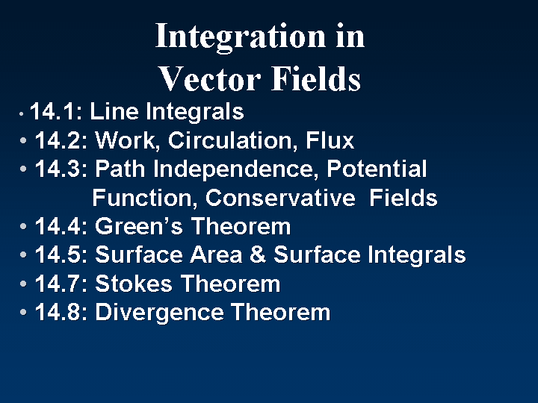
16
16
16
16
16
16
16

Slide 2
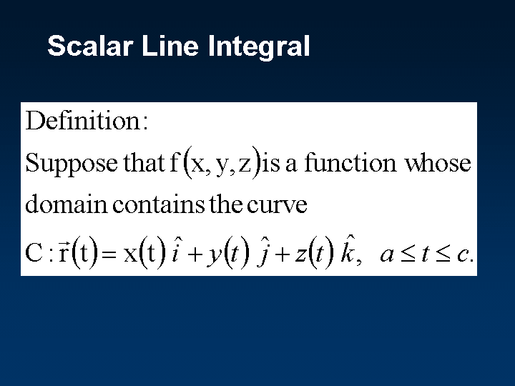

Slide 3
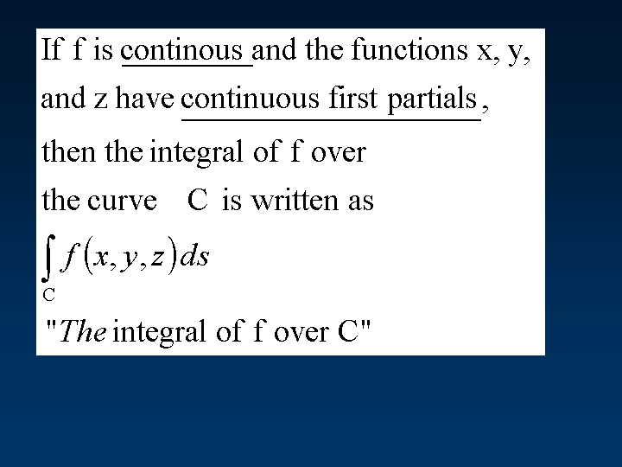

Slide 4
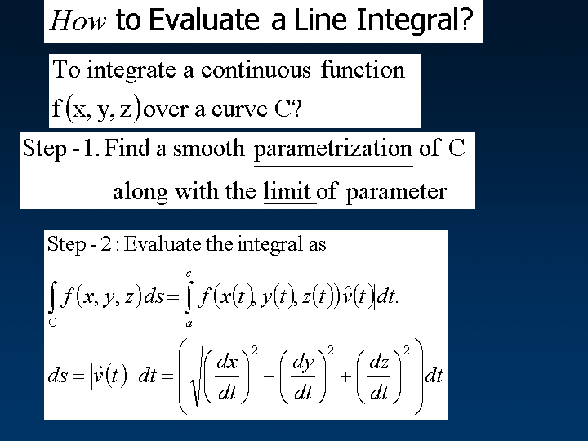

Slide 5
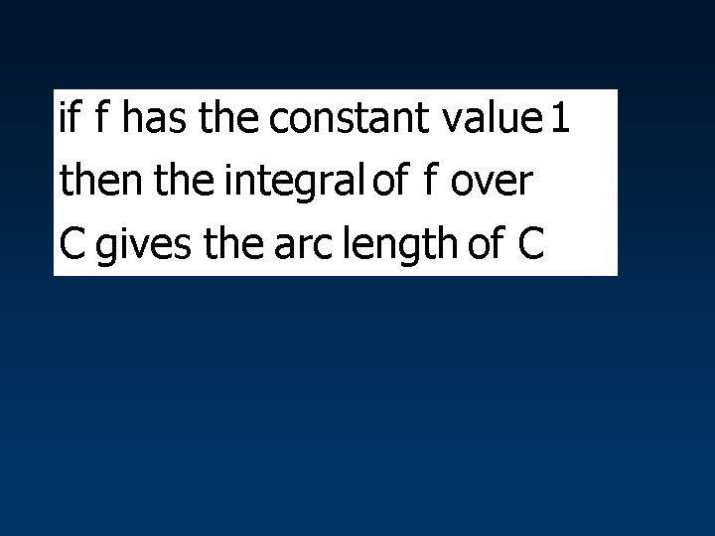

Slide 6
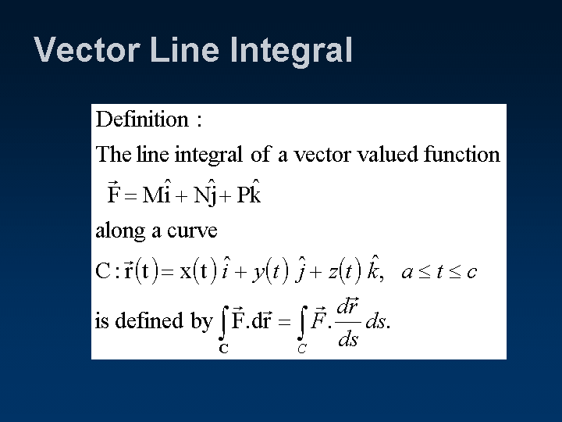

Slide 7
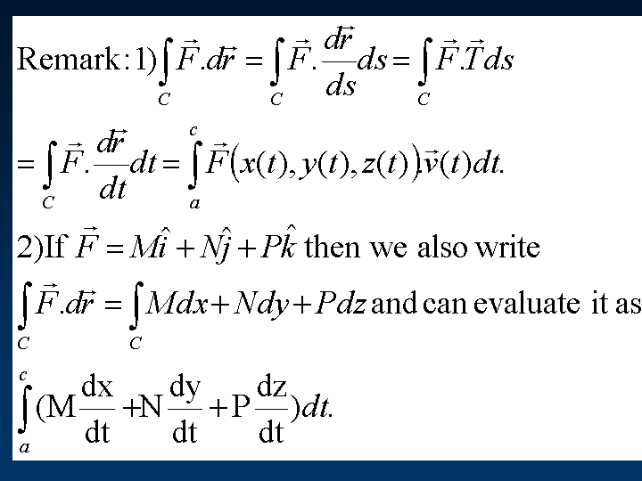

Slide 8
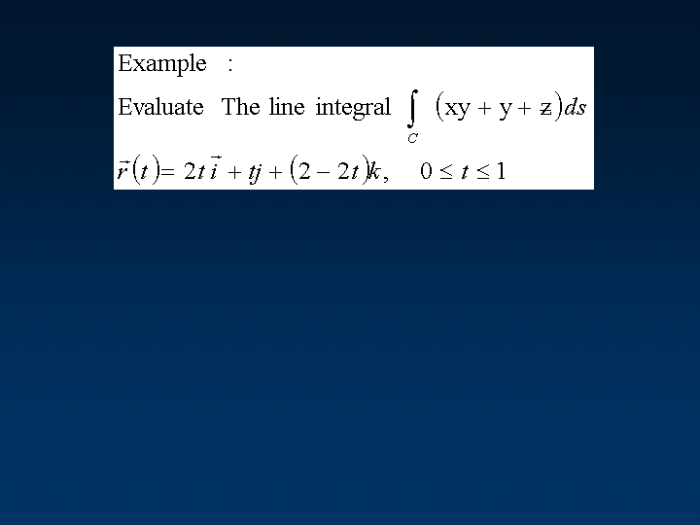

Slide 9
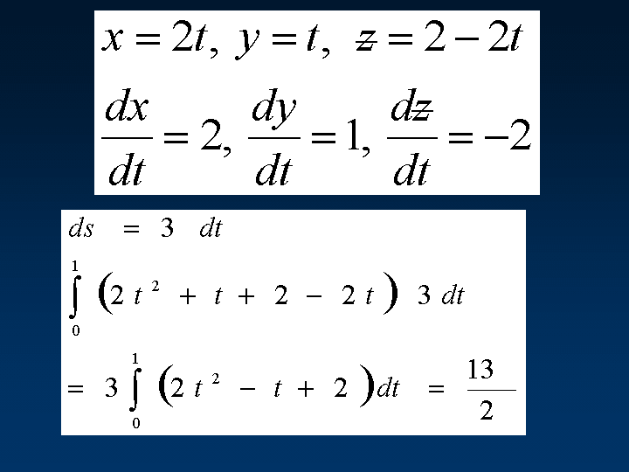

Slide 10
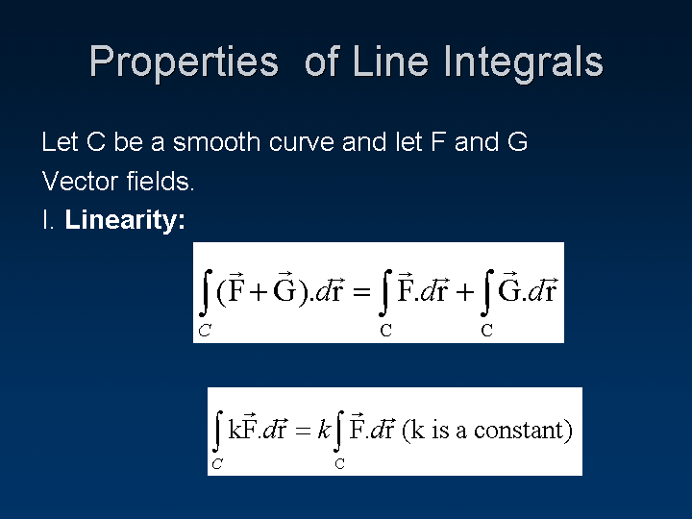

Slide 11
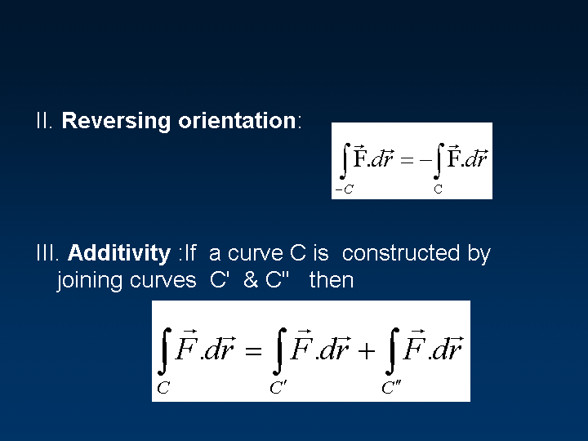
Not true for integrals of scalar functions.

Slide 12
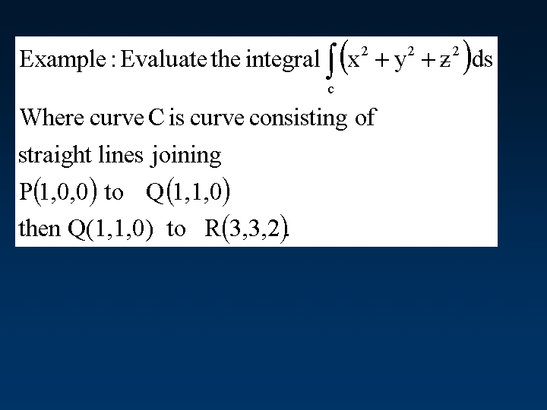
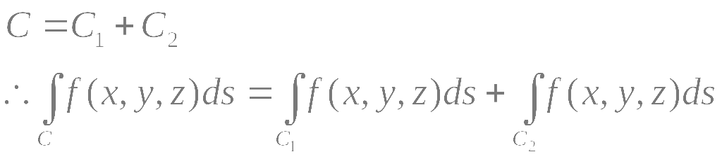

Slide 13
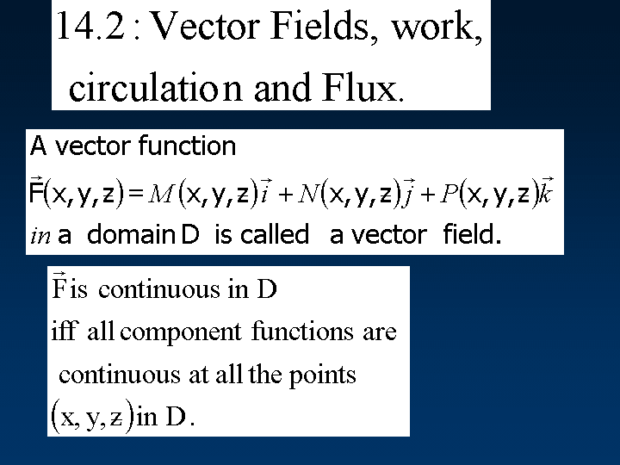

Slide 14
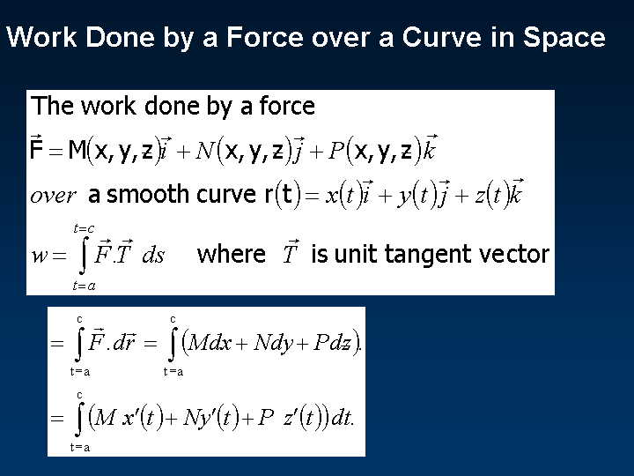




Slide 15
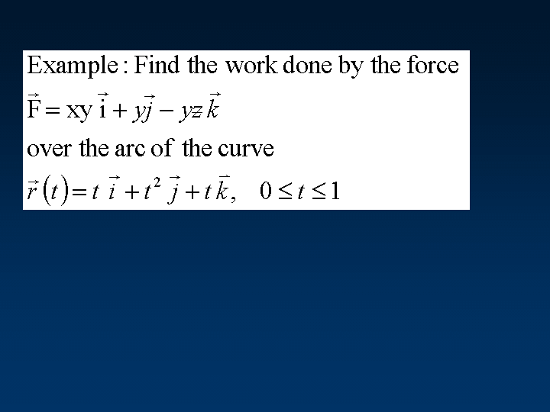

Slide 16
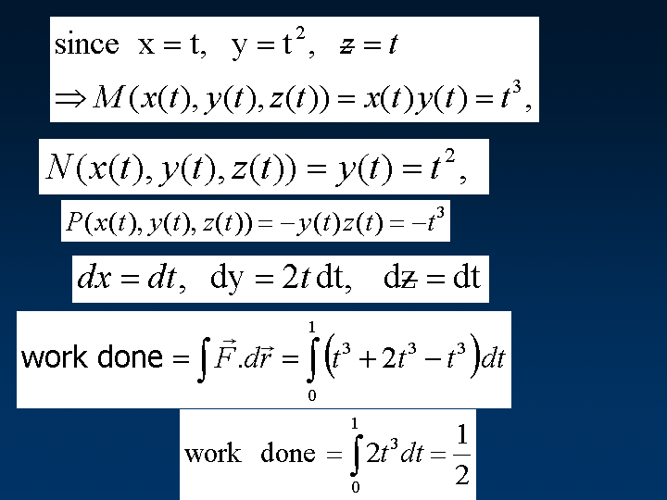

Slide 17
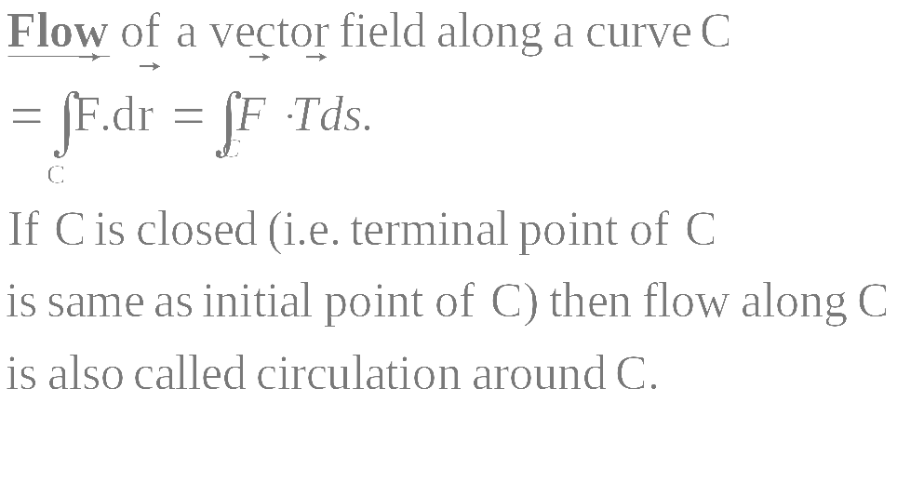

Slide 19
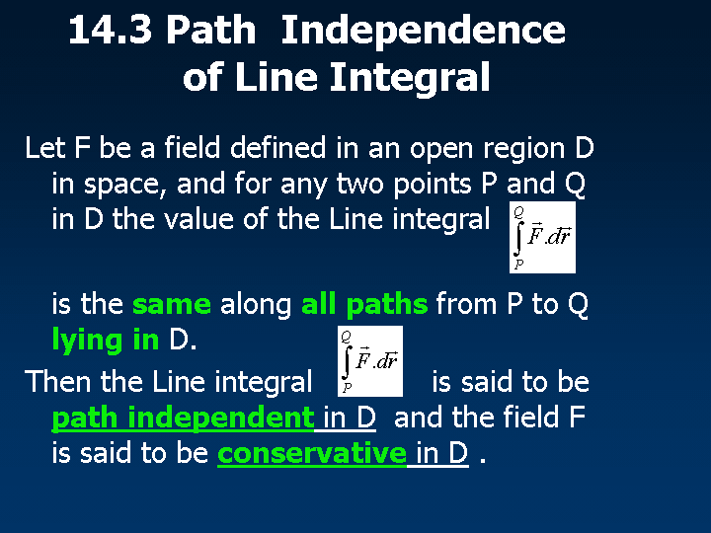
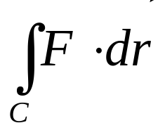
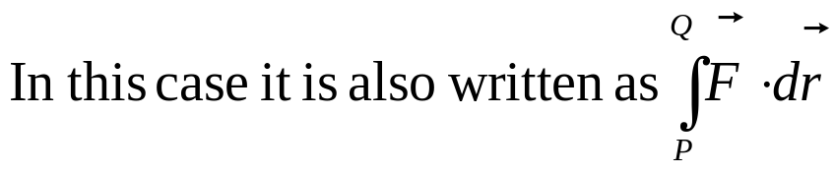
16

Slide 20


Slide 21
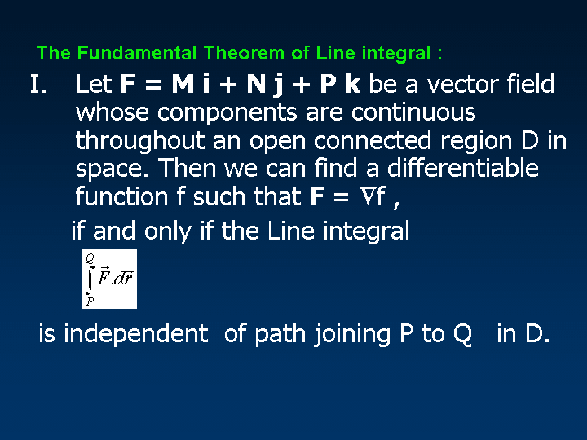

Slide 22
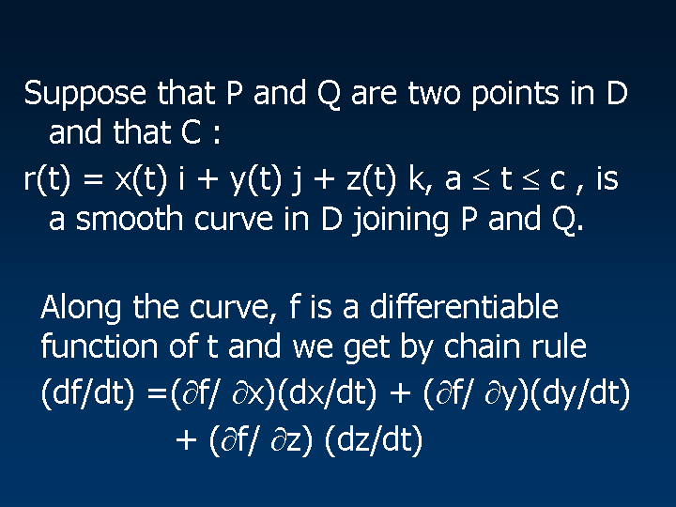
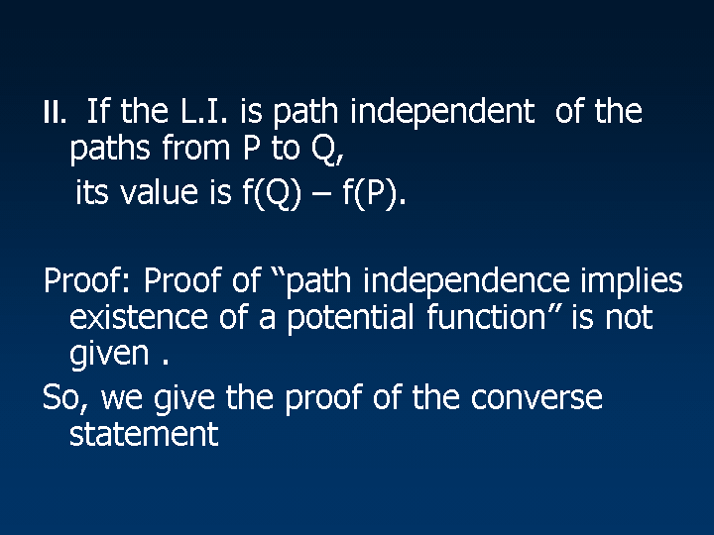

Slide 23
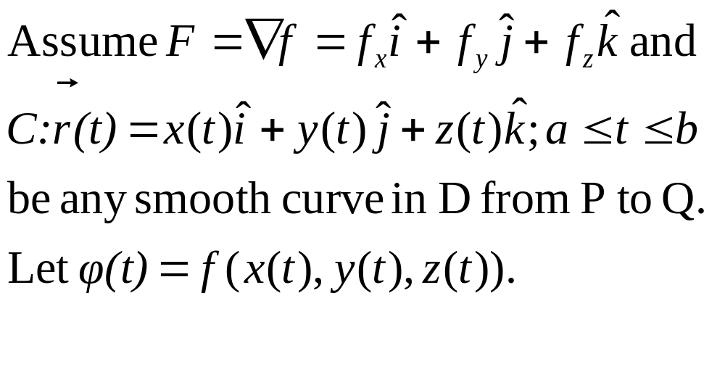

Slide 24
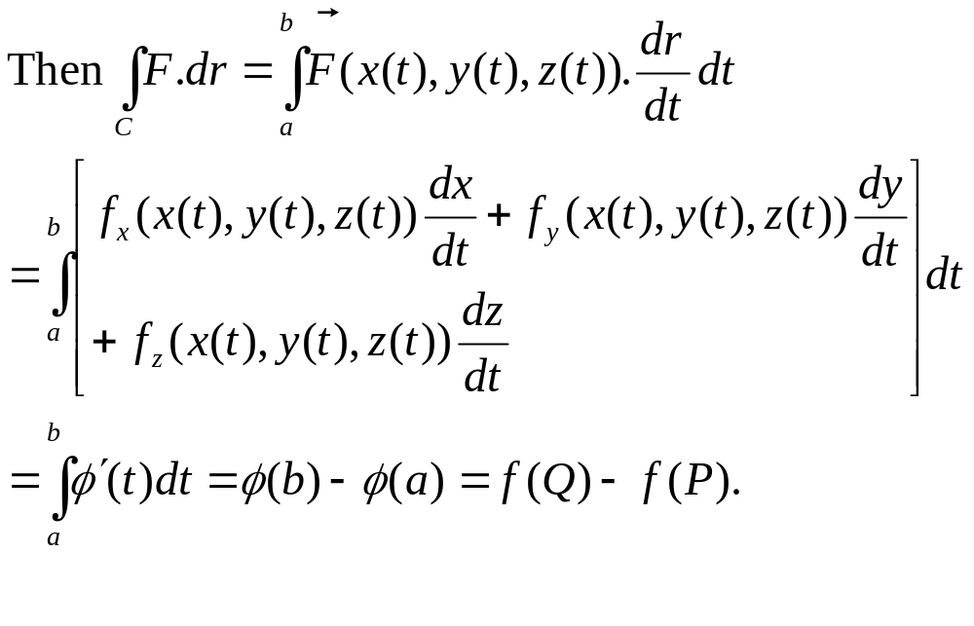

Slide 25
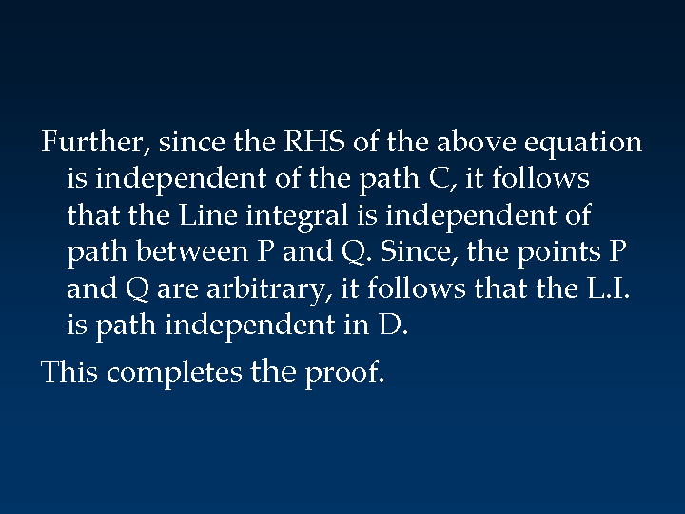

Slide 26
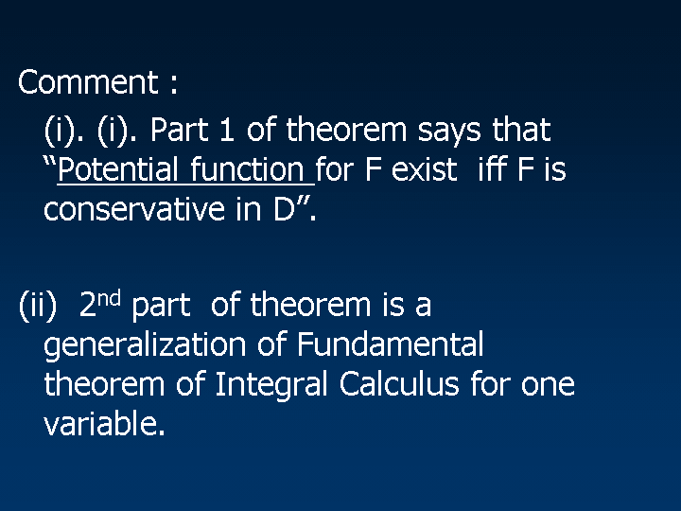

Slide 27
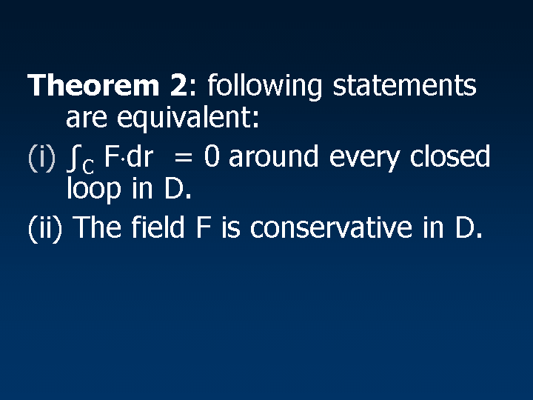
A curve is called closed if its initial point and
terminal point are same.

Slide 28
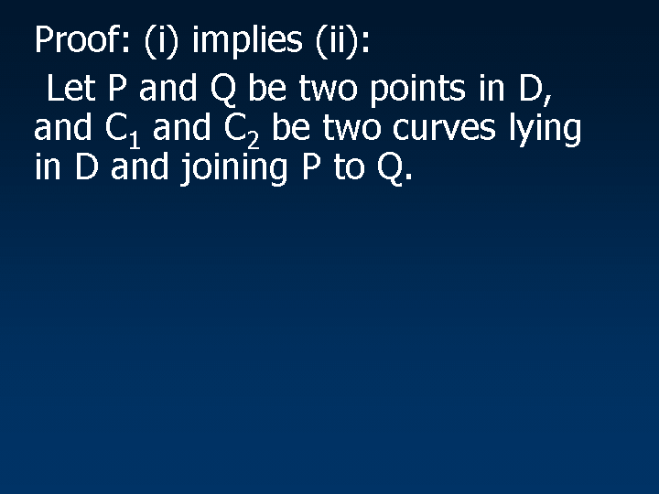

Slide 29
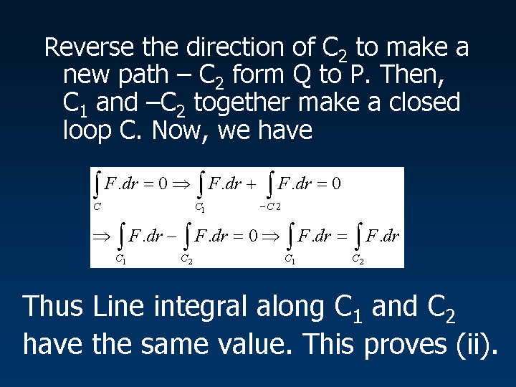

Slide 30
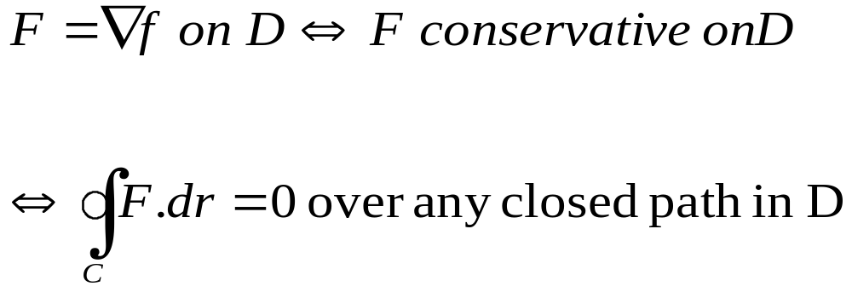
Remark : Combining Theorems 1 & 2,
Theorem 1
Theorem 2

Slide 31
How to Test Whether a given field F Conservative vector Field.
An open set D of R² or R³ is called connected
if any two points of D can be joined by a curve
lying completely in D.
A set D of R² or R³ is called simply connected
if any closed curve(i.e. loop) in D can be
contracted to a single point without leaving D.

Slide 32
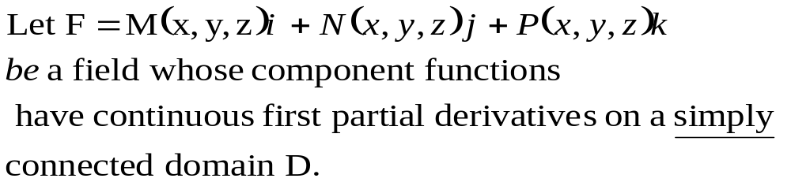
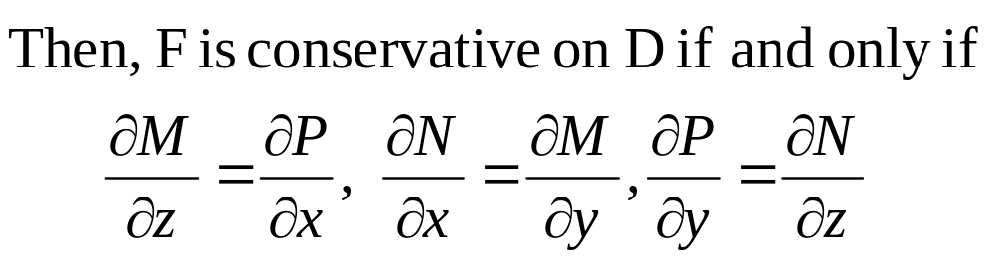
How to Test Whether a given field F Conservative vector Field.

Slide 33
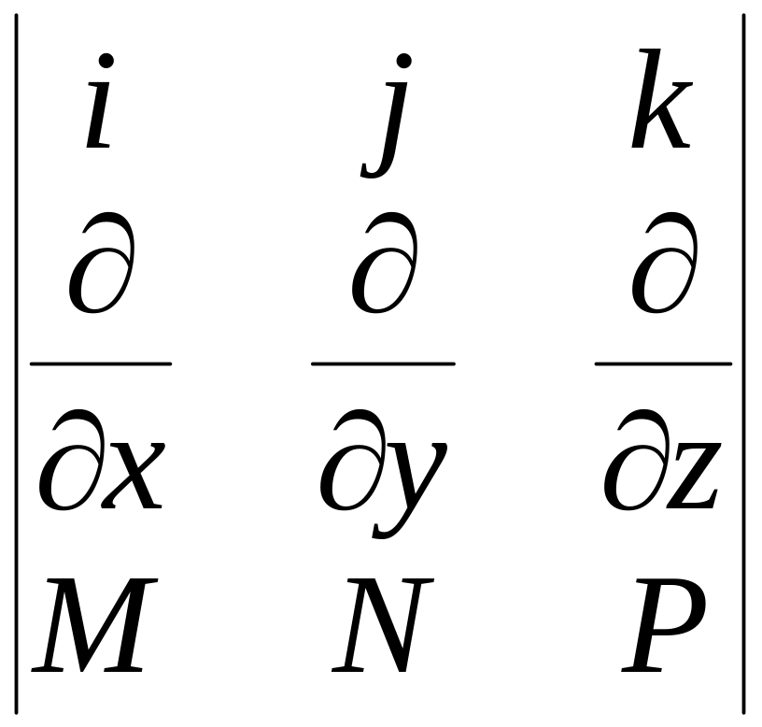
If F is a vector Field then curl F can defined as
F = M i +N j + P k
Curl F = ∇× F =
That is Curl (F) = 0.
for F to be conservative

Slide 34
Exact Differential Forms:
The form M dx + N dy + P dz
is called a differential form.
This differential form is called exact on a domain D, if we can find some function f (x, y, z) such that
M = ∂f/ ∂x, N = ∂f/ ∂y & P = ∂f/ ∂z
throughout D.

Slide 35
Remark : That is, the differential form in the integral is exact, same as saying that the vector field F = M i + N j + P k is conservative in D.
Test for Exactness of differential form:
M dx + N dy + P dz is exact in D if and only if
∂P/∂y = ∂N/∂z , ∂P/∂x = ∂M/∂z & ∂M/∂y = ∂N/∂x in D.
That is Curl (F) = 0.

Slide 36
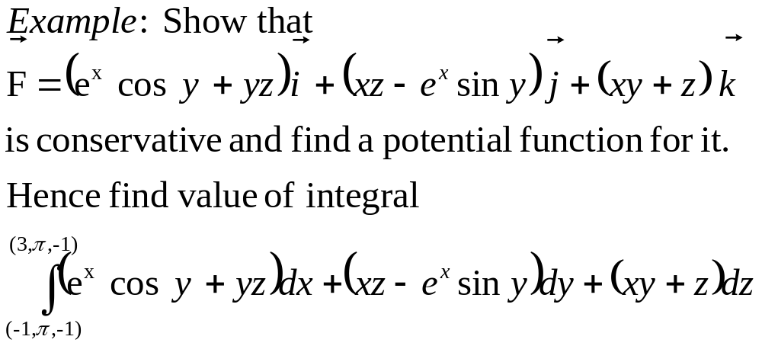

Slide 37
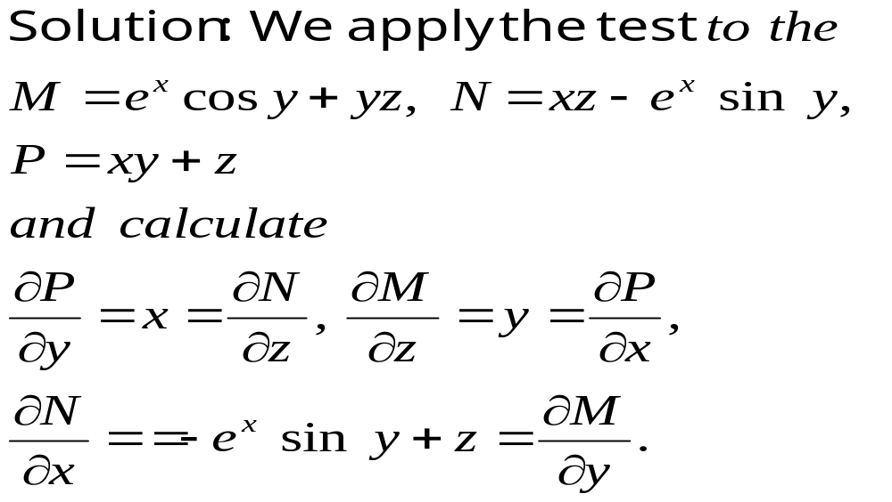
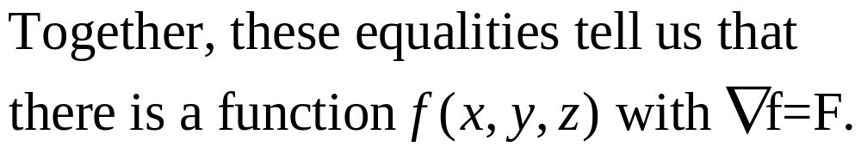

Slide 38
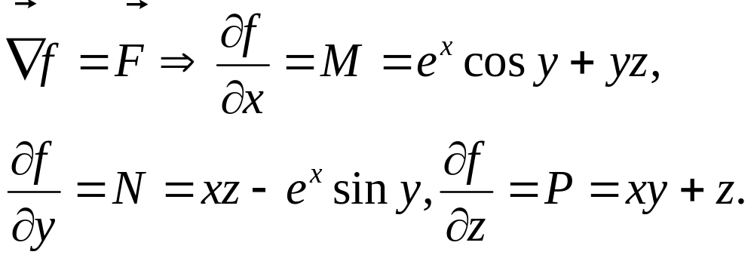
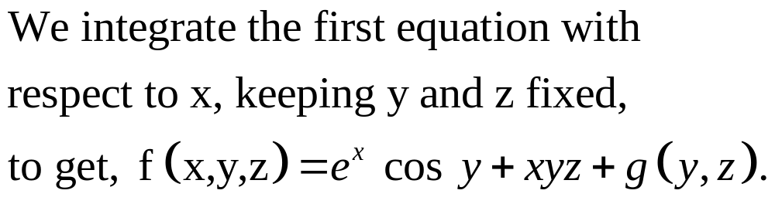
Constant of integration

Slide 39
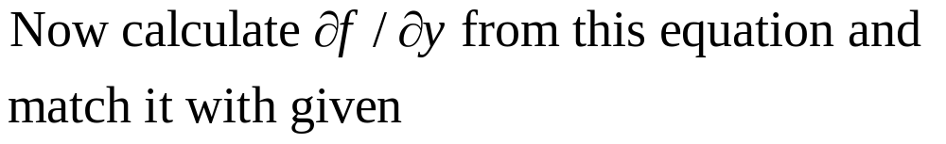
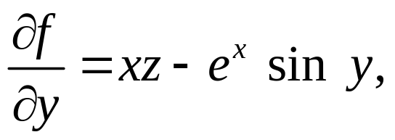
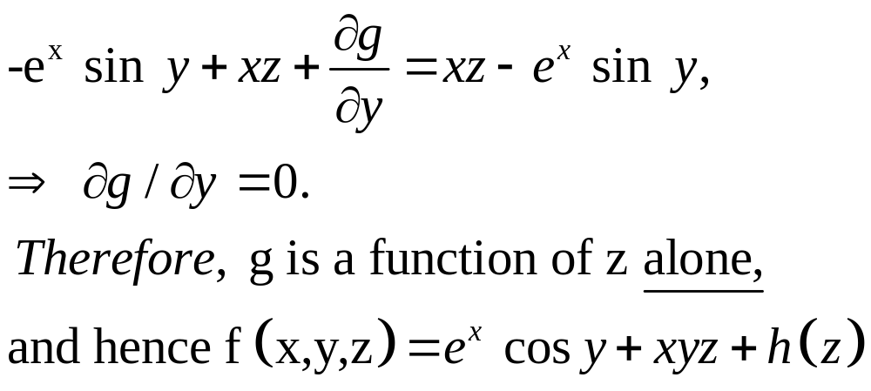

Slide 40
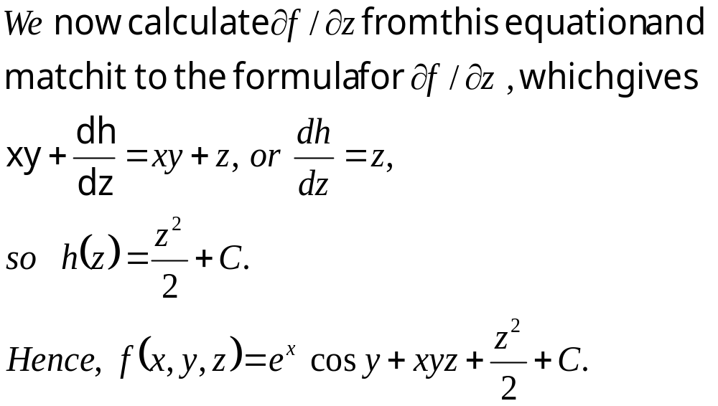

Slide 41
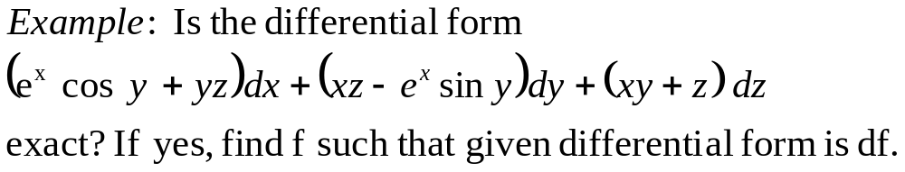
This is just the reformulation of the previous
problem. You just add the line the differential form
is df if and only if the vector field in the previous
problem is grad f, and then repeat the
solution of the previous problem.

Slide 42
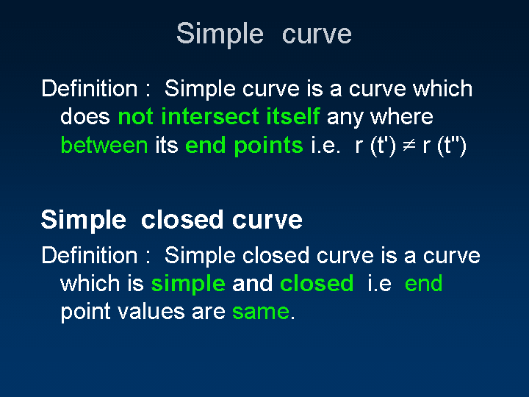
if t’ ≠t’’.
Except when {t′, t′′}={a,c} where a, c are min and max values of t.
The simple closed curve C is traced in counterclockwise or
anticlockwise sense if the region bounded by C lies to its left.

Slide 43
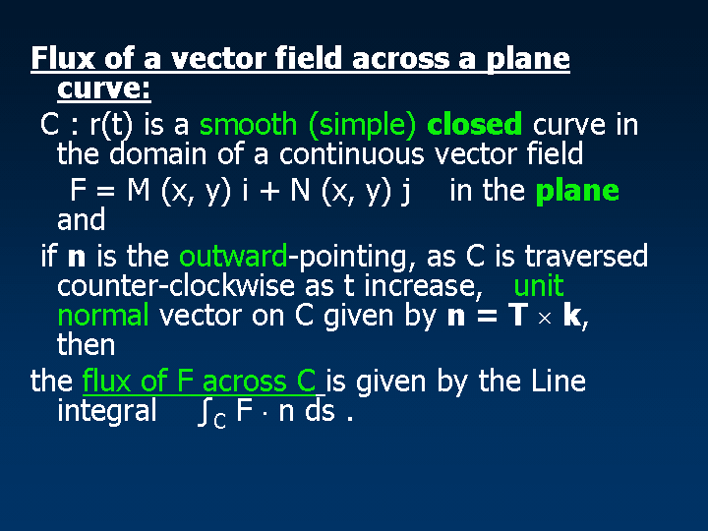

Slide 44
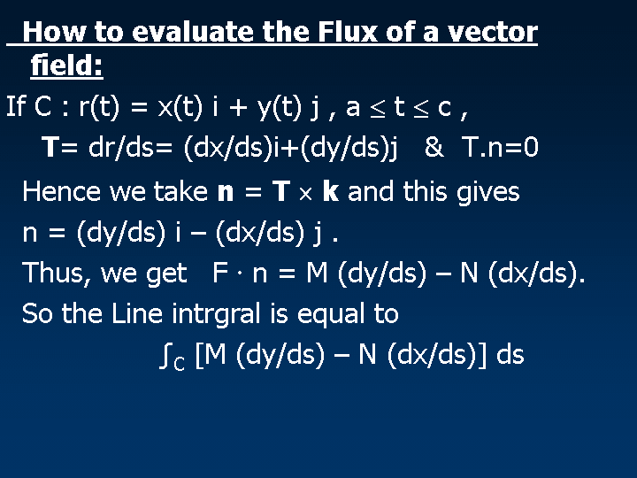

Slide 45
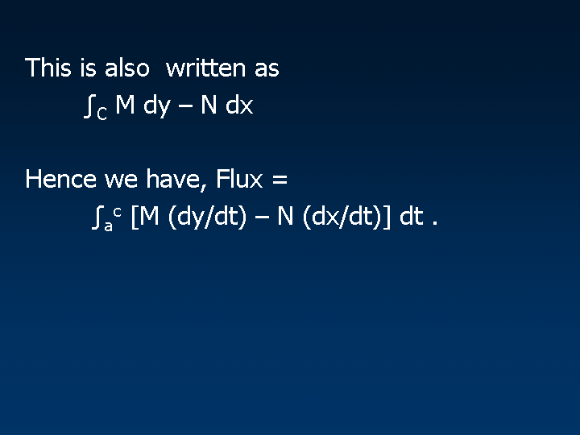

Slide 46
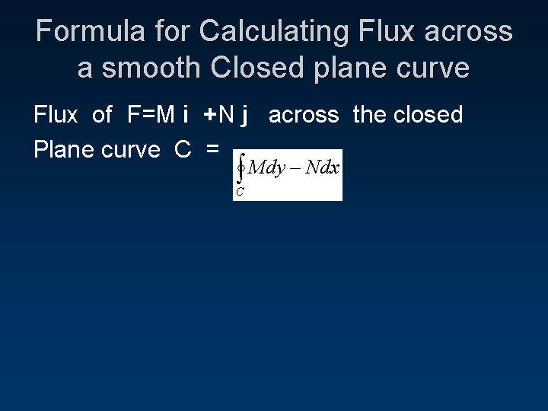

Slide 47


Slide 48


Slide 49


Slide 50


Slide 51


Slide 52


